Slide 1

Mini Project 2: Shark Vs Python
Group Members
Vasiliki
Eileen
Marina
Louis

Slide 2

PROJECT OVERVIEW
Dataset: Reports of shark attacks all over the world​
Time interval: 1800-2024​
Data info: Date / Time / Location (Country, State, County) / ​ Type of Activity / Injuries / Age / Sex / Species / Source​
Project Objectives
Research Team for the US Authorities to identify​
Areas of high frequency of shark attacks &​
Related factors (Time / Season / Activity)​
Fatality Rates​
Roadmapping
Navigating through the dataset to understand the information provided
Data processing : Cleaning and restructuring the data of interest
Exploratory Data Analysis + Data Visualization
Data insights
Shark or Python?

Slide 3
Challenges & Resolution
Date and time formatting
Challenges filtering by date and time of day to retain as many data points as possible for analysis.
A new set of time slots inside a day (morning, afternoon, and night) was introduced into a new column in order to identify a trend about the time of day when the attacks were more common.
Qualitative data
Columns "Injury" and "Activity" contained very various descriptions.
"Injury "- We grouped all kind of injuries by creating a pattern that identifies items that contain references to death or words that have similar meanings. We changed the column's values to: fatal/non-fatal.
"Activity " - Using a few keywords, we created a column to classify all the activities into four primary categories: swimming, water sports, fishing, and other. Additional categorising was necessary to guarantee precise and trustworthy outcomes.

Slide 4
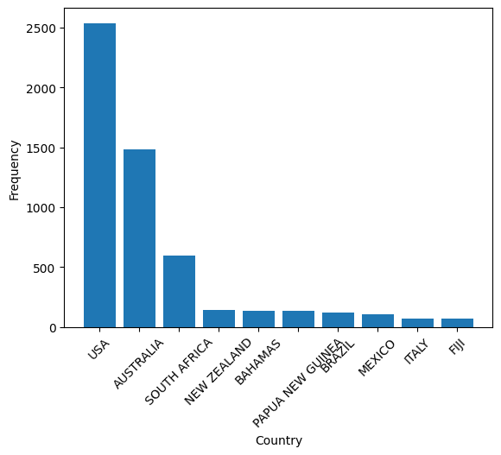
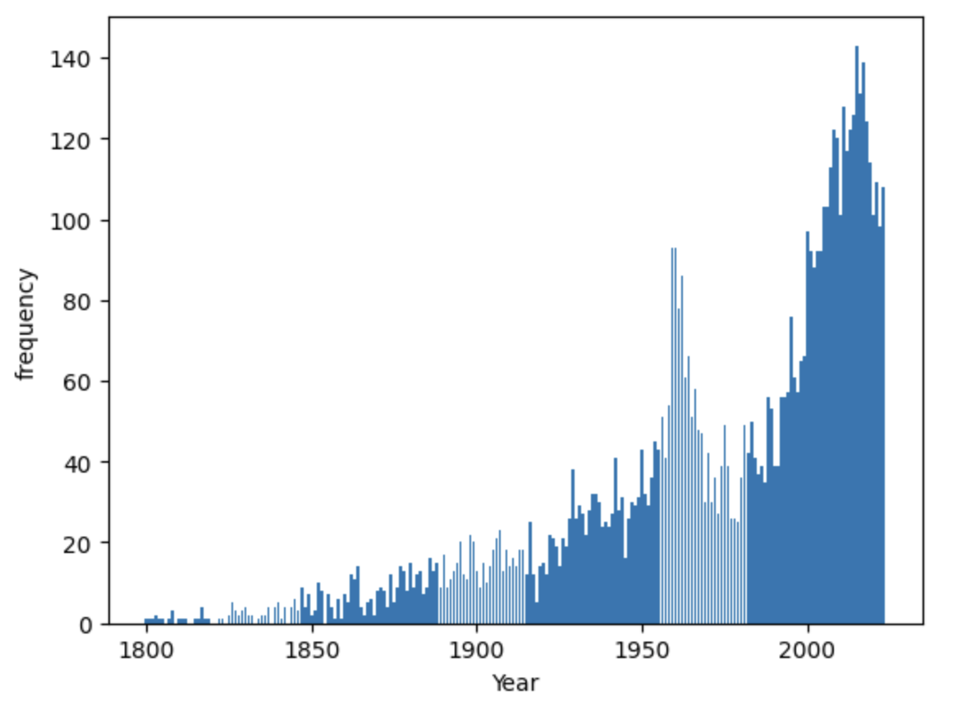
Exploratory data analysis:
Number of incidents registered by Country (Top 10)
Selected time frame: 2000 - 2023
Possible data bias in early years

Slide 5
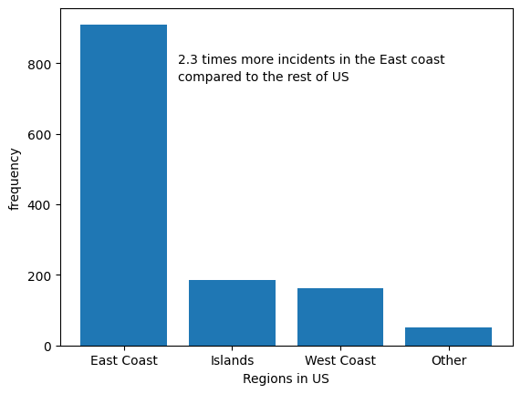
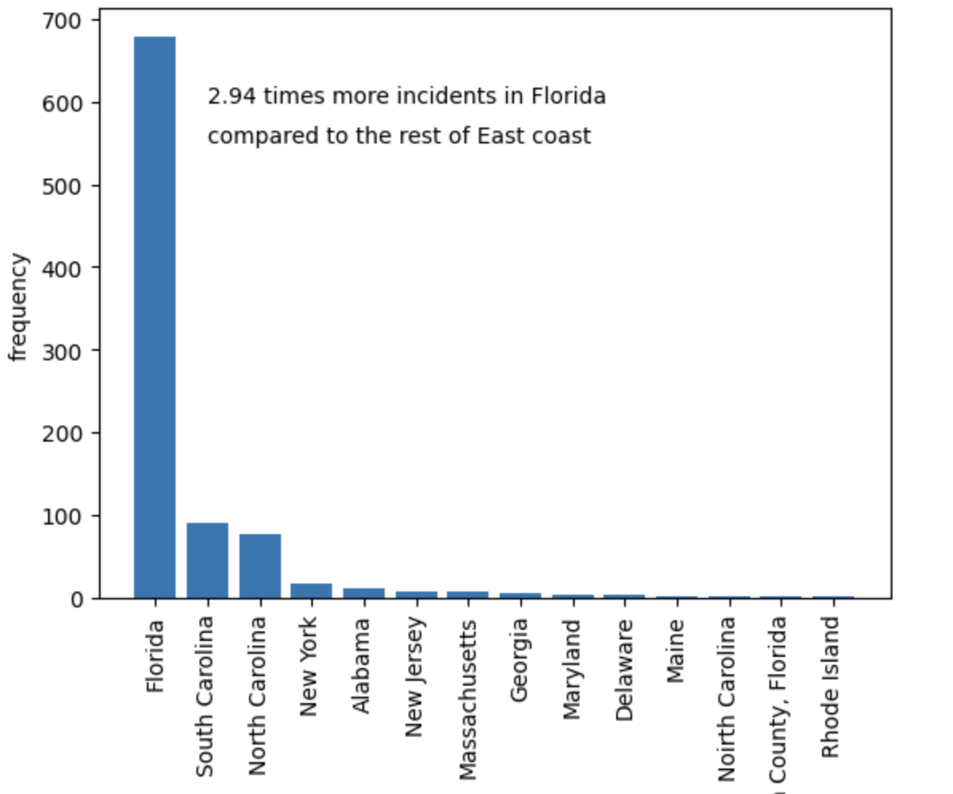
Exploratory data analysis:
Frequency of Incidents in the US Frequency of Incidents on the east coast
Florida: Area of high frequency in shark attacks​

Slide 6
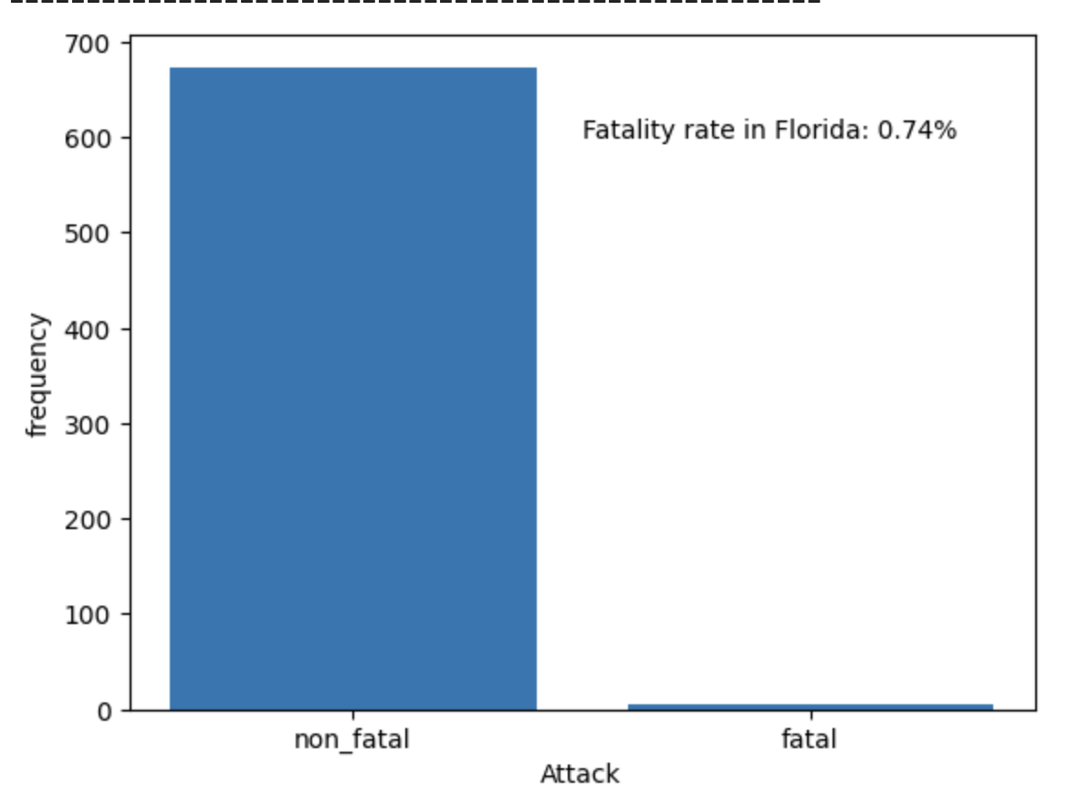
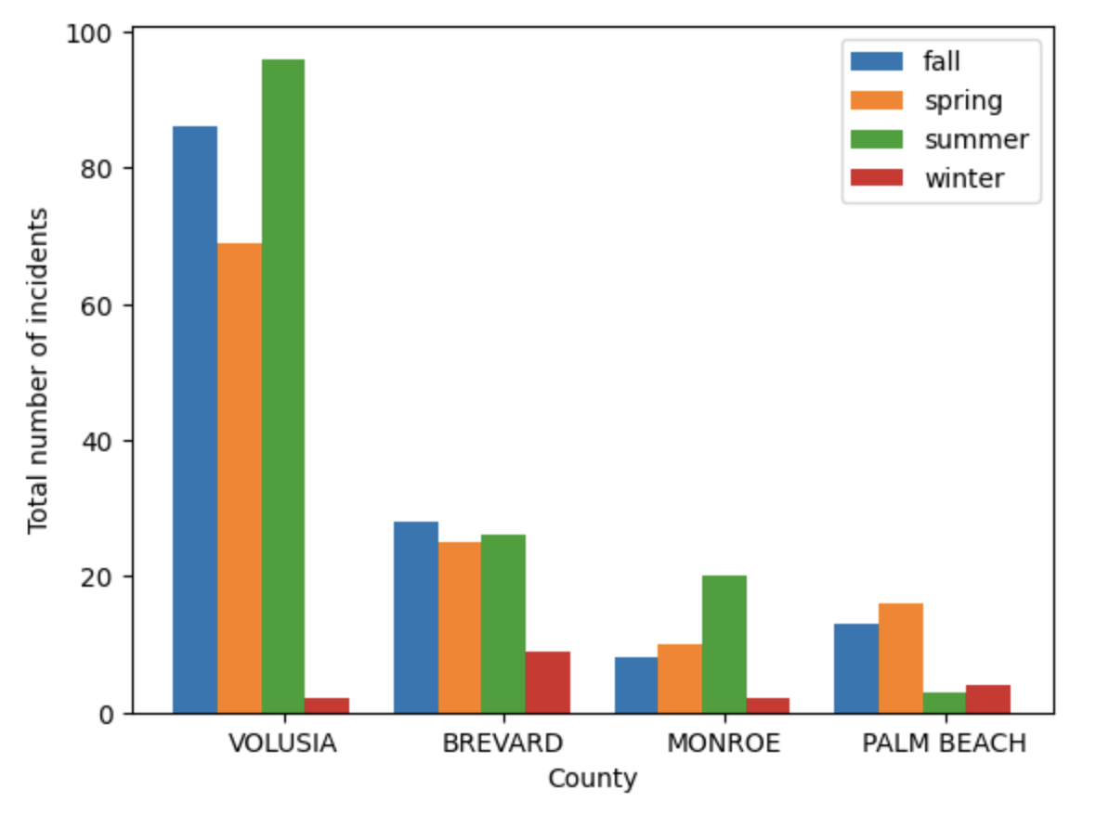
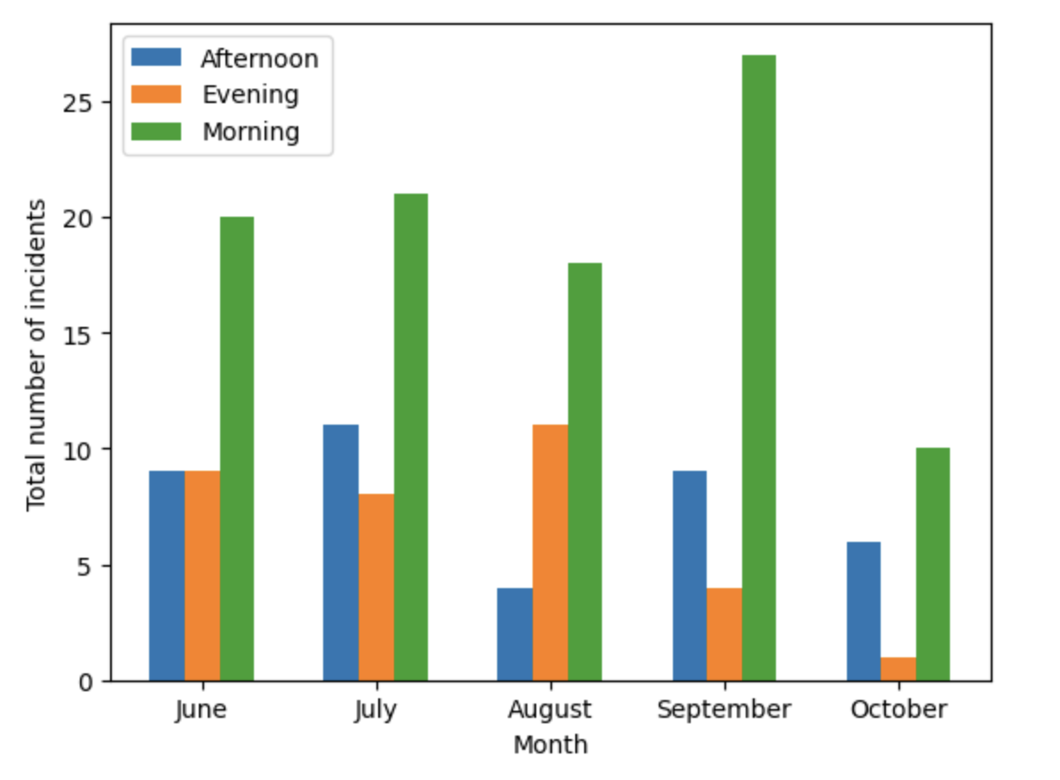
Conclusion & Insights
Frequency of fatal and non-fatal incidents
Frequency of incidents in 'top 4' Florida Counties per season
Frequency of incidents in Volusia County during high-peak months grouped by period within a day
Fatality Rates of are lower than expected
For each season the most shark attacks happen in Volusia besides winter
Shark attacks most likely happen in the morning

Slide 7

Major Obstacle
There was no given objective from the beginning
We had to explore the data first to find out before having an idea what the data could be useful for
The more we learned about the data, the more ideas we had on how we could utilize it

Slide 8
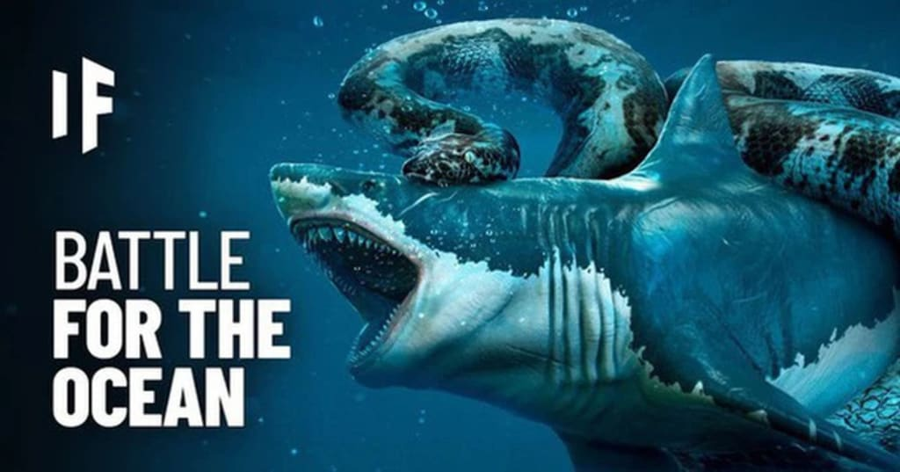
Vassiliki, Marina,
Louis, Eileen
Closing Slide (1 slide): Your project’s name, your names, and a “Thank You” message.
Shark or Python?
Python
won!!!
Thanks you
for your attention

